Slide 1
Initial Discussion on WoT-oneM2M Interworking
Yongjing Zhang
zhangyongjing@huawei.com

Slide 2
Content
Interworking Scenarios
Information Model Mapping

Slide 3
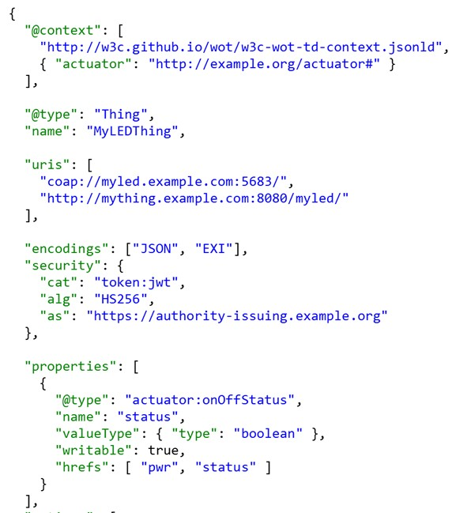
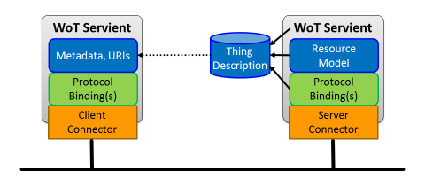

Interworking Scenarios (1)
Exposing oneM2M interfaces to WoT systems
benefit: oneM2M services/data can be consumed by WoT entities (servients)

Slide 4
Interworking Scenarios (2)
Transparent Interworking (encapsulate whole WoT data model into oneM2M (flex)containers)
benefit: easy integration with WoT systems
limitation: non-semantic interoperability
Application (AE)
(Hybrid: WoT data model aware + oneM2M i/f compliant)
Sensor/Meter
Sensor/Meter
provides
WoT data model (TD)
WoT i/f
WoT i/f
uses
uses
AE
Inter-working Proxy
AE
Inter-working Proxy
encapsulates
WoT TD
(serialized)
Mca
Mca
Mca
<container> or <flexContainer>
CSE
CSE
MN
Mcc
Infrastructure Node

Slide 5
Interworking Scenarios (3)
Direct Resource mapping with WoT TD (like SDT/HAIM mapping, or AllJoyn Interworking)
benefit: finer granularity of data handling (deeper insight)
limitation: oneM2M AE still needs to understand WoT TD data model to a certain extent.
Application (AE)
(Hybrid: WoT data model aware + oneM2M i/f compliant)
Sensor/Meter
Sensor/Meter
provides
WoT data model (TD)
uses
WoT i/f
WoT i/f
uses
AE
Inter-working Proxy
AE
Inter-working Proxy
encapsulates
WoT TD
(structured mapping)
Mca
Mca
Mca
structured <container> or <flexContainer>
CSE
CSE
MN
Mcc
Infrastructure Node

Slide 6
Interworking Scenarios (4)
Semantic Interworking (using generic interworking framework and Base Ontology mapping)
benefit: semantic interoperability, & automated
limitation: ontology mapping may not be fully compatible
Utility Application (AE)
(oneM2M native)
Sensor/Meter
Sensor/Meter
provides
WoT TD
WoT i/f
WoT i/f
uses
Ontology Mapping
uses
AE
Inter-working Proxy
AE
Inter-working Proxy
Translates&
encapsulates
Base Ontology
Mca
Mca
Mca
<container> or <flexContainer>
CSE
CSE
MN
Mcc
Infrastructure Node

Slide 7
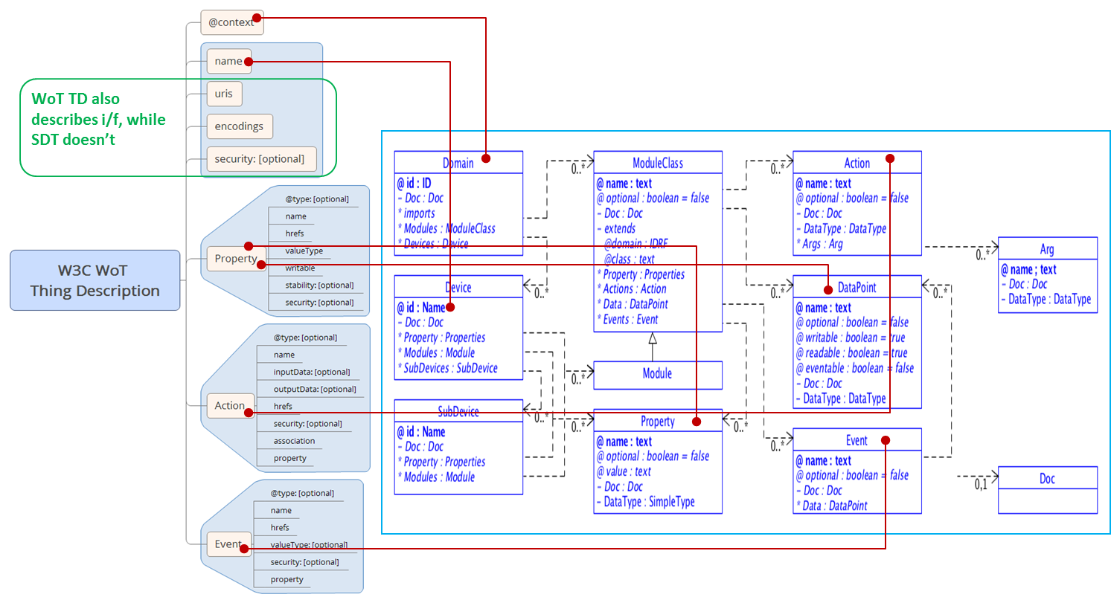
Information model mapping (1)
W3C WoT TD vs. oneM2M/HGI SDT

Slide 8
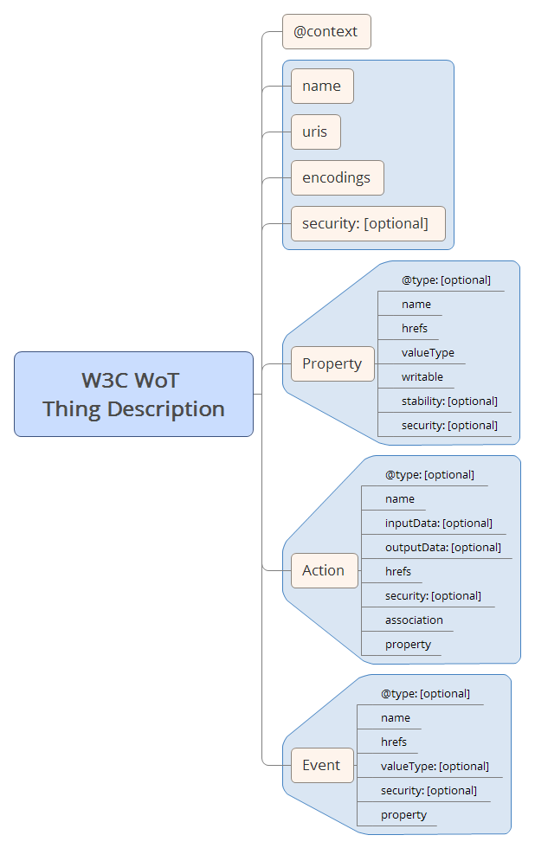
Information model mapping (2)
W3C WoT TD vs. oneM2M Base Ontology
BO defines upper layer semantics for human understanding
oneM2M doesn’t model ‘event’.

Slide 9
Information model mapping (3)
W3C WoT TD vs. oneM2M <semanticDescriptor>
oneM2M SD supports semantic discovery/query, while WoT TD doesn’t yet.
oneM2M SD is more distributed to resource level, while WoT TD is more at the ‘thing’ level.
oneM2M SD is using RDF/XML while WoT TD uses JSON-LD

Slide 10
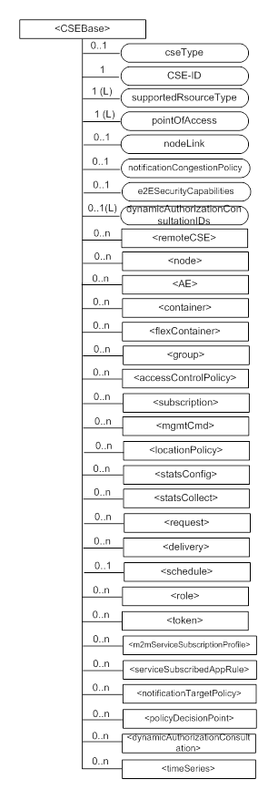
Information model mapping (4)
W3C WoT TD vs. oneM2M resources in general
WoT metadata/data is stored in a more centralized way in TD, while oneM2M metadata/data is more scattered into different resource types.

